Slide 1

What is the first book of modern psychology called and when was it first published?
DAY 3
Place Date Here
Principles of Psychology
by William James
Write answer in a complete sentence or no credit
Notes:
Principles of Psychology by William James

Slide 2


THE BIG DEBATE
Nature vs. Nurture
- debate about the extent to which particular aspects of behavior are a product of either inherited (nature, genetic) or acquired (nurture, learned) characteristics.
NATURE
VS. NURTURE
Notes:
We will see this Nature v Nurture debate throughout this class. Personality and intelligence

Slide 3
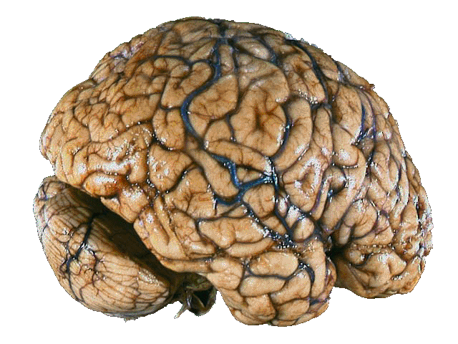
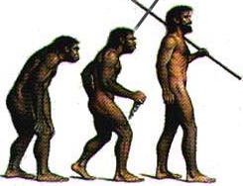
II. APPROACHES
BIOLOGICAL
behavior & mental processes are largely shaped by the nervous system: brain, hormones, genes.
EVOLUTIONARY
- Darwinism
- emphasizes ways in which behavior & mental processes are adaptive for survival
APPROACHES
Notes:
Biological -They have shown that certain parts of the brain are highly active when listening to music, or other parts are active when solving math problems.
- A Biopsychologist might explain a person’s tendency to be extroverted as caused by genes inherited from their parents and genes’ effects on the abundance of certain neurotransmitters in the brain. It is one of the fastest growing fields in psychology because of all the latest discoveries about how the brain works.
Evolutionary (Darwinian) Perspective - Looks for psychological traits that might be advantageous for survival - these traits would be passed down from parents to the next generation.
--- They might explain a person’s tendency to be extroverted as a survival advantage. If a person is outgoing, they might make friends and allies. These connections could improve the individual’s chances for survival, which increases the person’s chances for passing this trait for extroversion down to his or her children.

Slide 4
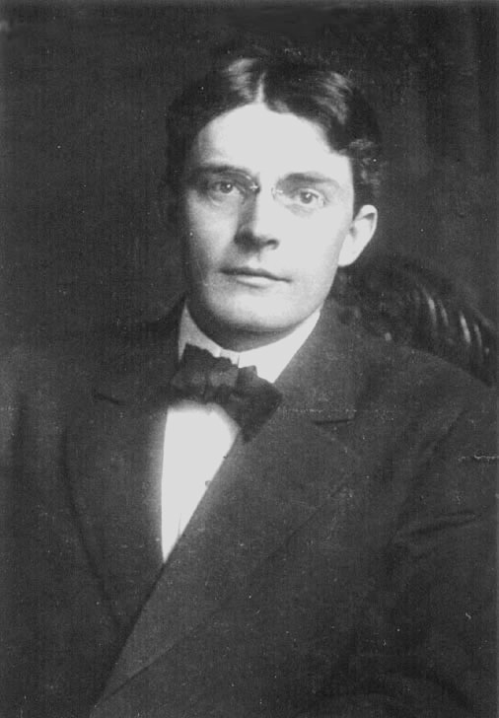
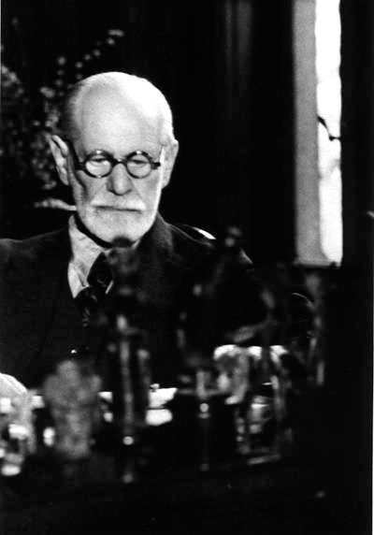
II. APPROACHES
PSYCHODYNAMIC
Founded by Freud
behavior comes from unconscious drives, usually stemming from childhood
BEHAVIORAL
- founded by Watson
- Emphasizes learning, especially each person’s experience with rewards & punishments
- focuses on OBSERVABLE behavior
JOHN B. WATSON
SIGMUND FREUD
APPROACHES
Notes:
As previously described - the unconscious mind - Unconscious motives motivate our behavior. So - obviously they believe to understand human thought and behavior, we must examine our unconscious mind through dream analysis, word association and other techniques. Psychoanalytic psychologist ming explain that an introverted person avoids social situation because of a repressed (or forgotten) or memory of trauma in childhood involving a social situation (may be they were publicly humiliated or embarrassed at school or a party) but doesn’t consciously remember.
Behaviorism - Founded by who? Explain human thought & behavior in terms of conditioning. They see all people’s behavior as a result of their environment. You think you have free will, however everything you do is a result of positive and negative reinforcement.
-----A behaviorist might explain a person’s tendency to be extroverted in terms of reward and punishment. Was the person reward for being outgoing? Was the person punished for withdrawing from a situation or not interact with others? A behaviorist would look for environmental conditions that caused an extroverted response in the person.

Slide 5

II. APPROACHES
COGNITIVE
Emphasizes ways in which people receive, store, retrieve & process info
how we see the world
how we react to sad & happy events
HUMANISTIC
Emphasizes individual potential for growth & stress individual choice & free will.
- people’s choices
- people seek self-actualization
THE THINKER - RODIN
APPROACHES
Notes:
Cognitive - It’s the way people think. “They are interested in discovering how people process information in domains ranging from decision making and interpersonal attraction to intelligence testing and group problem solving.” Cognitive psychologists attempt to determine how these components produce complex behaviors such as remembering a fact, naming an object, or writing a word.
---A cognitive psychologist might explain a person’s tendency to be extroverted in terms of how he or she interprets social situations. Does the individual interpret others’ offers for conversation as an important ways to get to know someone or important for his or her own life in some way? To cognitive psychologist, an extroverted person sees the world in such a way that being outgoing makes sense.
Humanists believe that we choose most of our behaviors and these choices are guided by physiological, emotional, or spiritual needs.
----A humanistic psychologist might explain that an introverted person may choose to limit social contact wit others because he or she finds that social needs are better satisfied by contact with a few close friends rather than large groups. ------- They are NOT easily tested by the scientific method. - But some therapist use these ideas in aiding clients overcome obstacles in their life

Slide 6

II. APPROACHES
SOCIAL-CULTURAL
Focuses on how culture influences the way we think & act.
Examples: gender, race, age
Cornell Question Notes
APPROACHES
Notes:
SOCIAL CULT. - describes how our thoughts vary from people living in other cultures.
Examples: How far apart do people in this culture usually stand when they have a conversation? How often do people touch each other while interacting? How much value does the culture place on being part of a group vs being an individual.
---Cultural Norms would be important to a sociocultural psychologist in explaining a person’s extroversion.
If you ask psychologists which of these perspectives they most agree with, they might say that each perspective has valid explanations depending on the specific situation. This is sometimes called ECLECTIC, which claims that no one perspective has all the answers to the variety of human thought and behavior. Psychologists use various perspectives in their work depending on which point of view fits best with the explanation.

Slide 7
It’s Time to Play
Name that Psychological Approach!
A. Biological D. Cognitive
B. Psychoanalytic E. Humanistic
C. Sociocultural F. Behavioral

Slide 8
It’s Time to Play
Name that Psychological Approach!
This approach emphasizes internal conflicts, mostly unconscious, causing anxiety.
Psychoanalytic Approach

Slide 9
It’s Time to Play
Name that Psychological Approach!
Emphasizes individual potential for growth & stress individual choice & free will.
Humanistic Approach

Slide 10
It’s Time to Play
Name that Psychological Approach!
Emphasizes ways in which people receive, store, retrieve & process information
Cognitive Approach

Slide 11
It’s Time to Play
Name that Psychological Approach!
Emphasizes the influence culture has on the way we think and act.
Sociocultural Approach

Slide 12
It’s Time to Play
Name that Psychological Approach!
Emphasizes learning, especially each person’s experience with rewards & punishments
Behavioral Approach

Slide 13
It’s Time to Play
Name that Psychological Approach!
behavior & mental processes are largely shaped by the nervous system: brain, hormones, genes.
Biological Approach

Slide 14

What are the five major approaches of psychology?
Notes:
Day 3 Exit Ticket

